Slide 1
Ezekiel 22-24
“…cause her to know all her abominations” (22:1)

Slide 2
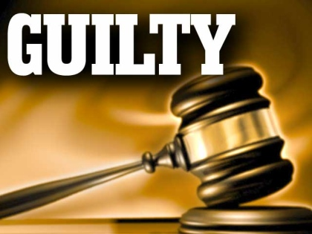
Ezekiel 22
Necessity of Judgement for Judah is examined. The land was absolutely, irredeemably corrupt.
The Bloody City (22:1-16)
The Blast Furnace (22:17-22)
The Corrupt Land (22:23-31)

Slide 3
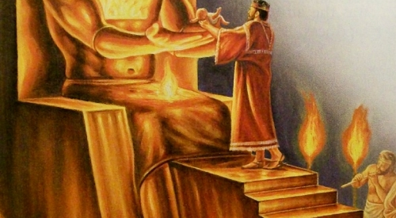
Ezekiel 23
Necessity of Judgement for Judah is examined. The land was absolutely, irredeemably corrupt. Israel is represented as two sisters Oholah and Oholibah who belonged to God but played the harlot…
Their Lewdness: Round #1 (23:5-21)
Their Punishment (23:22-35)
Their Lewdness: Round #2 (23:36-44)
Their Punishment (23:45-49)

Slide 4
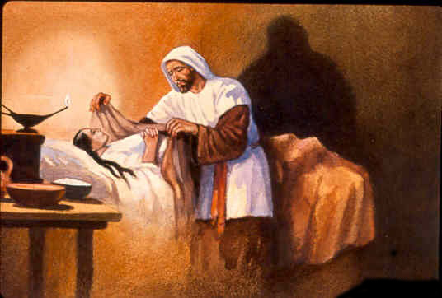
Ezekiel 24
On the day Jerusalem came under siege, Ezekiel was busy about his ministry in Babylon. He would suffer a great personal loss that day and be used as a sign to Judah.
A Message in Parable Form (24:3-14)
Ezekiel’s Wife Dies (24:15-24)
Ezekiel’s Mouth to Be Opened (25-27)

